Slide 1

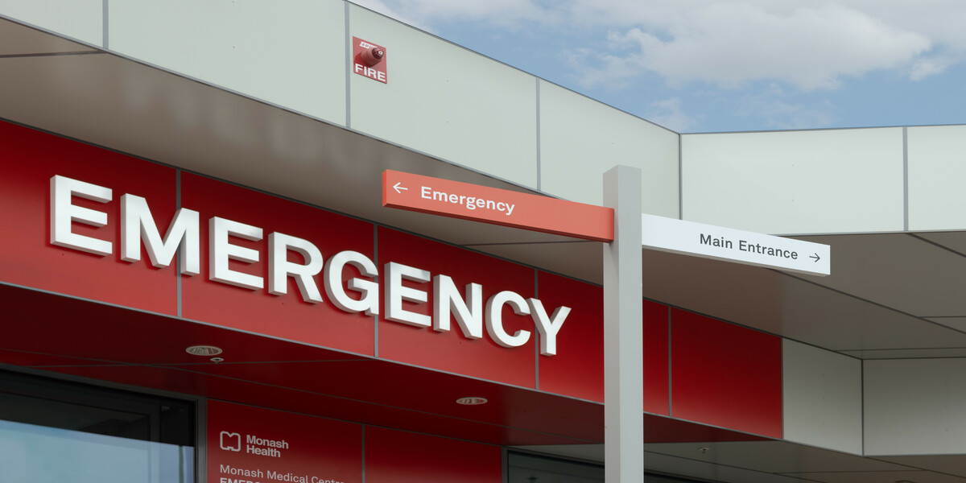
AI-Based Triage in Emergency Departments: A New Frontier in Healthcare
Group 1
Anush De Costa
Asal Valisoltani
Deon Joshua
Dhiraj Kapoor

Slide 2
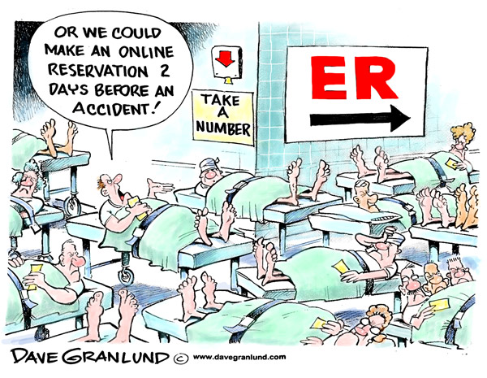
Problem?
Overcrowding and high patient volumes often result in long waiting times and delays in patient care in emergency departments. In such a high-stakes environment, the decision-making process is crucial.

Slide 3
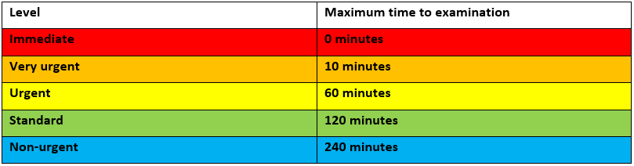
Why using AI in Triage?
With AI, we have an opportunity to improve efficiency and accuracy in emergency departments. AI-based triage systems can rapidly assess and prioritize patients, reducing waiting times and potentially improving patient outcomes. Furthermore, it can lessen the load on healthcare professionals, allowing them to focus on providing care.

Slide 4
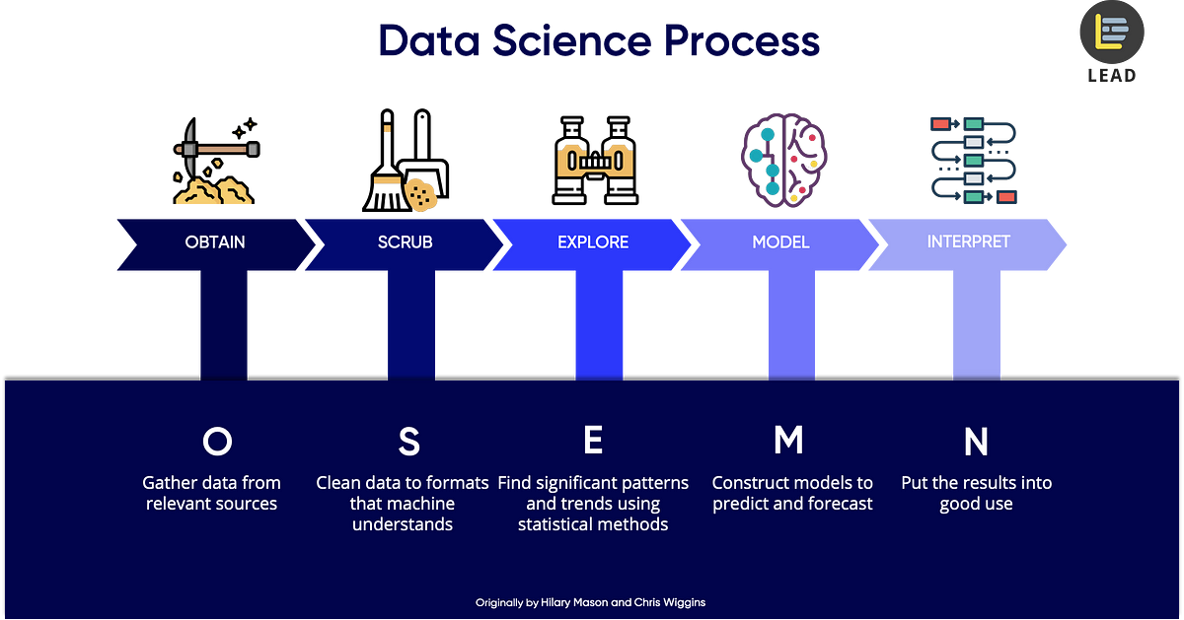

Slide 5
Data Source:
Korean Triage Study
The KTAS, or Korean Triage and Acuity Scale, is a system used to prioritize patients in emergency departments based on the severity of their condition. It is the standard triage tool used in South Korea, adapted from the Canadian Triage and Acuity Scale (CTAS).
The KTAS (Korean Triage and Acuity Scale) score is based on a range of factors that are used to assess a patient's condition. It's a comprehensive evaluation that includes but isn't limited to:
Vital Signs
Presenting Symptoms
Medical History
Level of Consciousness
Pain Scale

Slide 6

Data Preprocessing
Handeling Null values
Highlighting Key Variables
Categorical vs Numerical Values
Scaling Numerical Values
Data Visualization

Slide 7
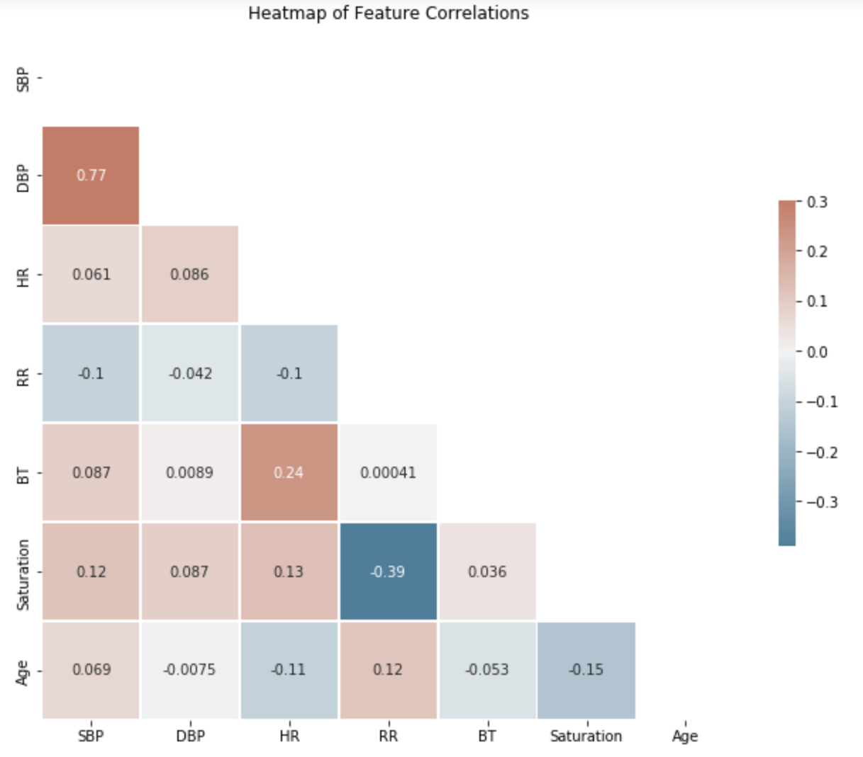
Correlation?

Slide 8

Machine Learning Modeling :
Supervised
Target
Features
Sex
Age
Arrival mode
Injury
Consciousness Level
Pain
Nurse assessment pain
Systolic Blood Pressure
Diastolic Blood Pressure
Heart Rate
Respiratory Rate
Body Temperature
Saturation
KTAS_Expert

Slide 9
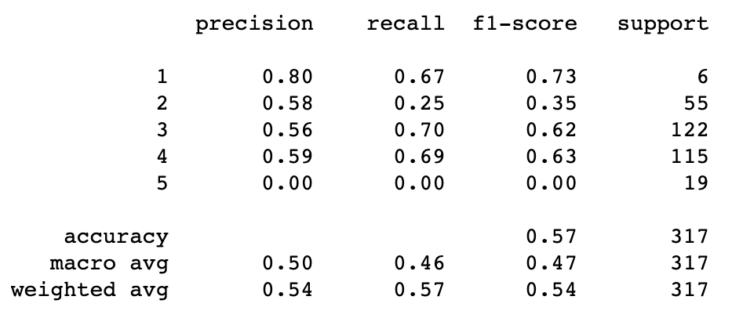
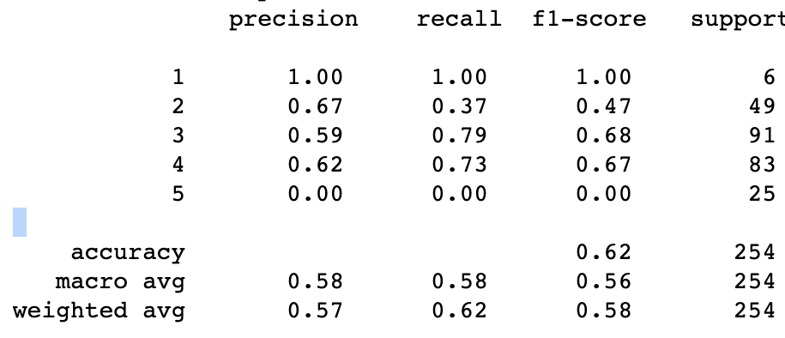
Machine Learning Modeling :
Supervised
Logistic regression
Random Forest

Slide 10
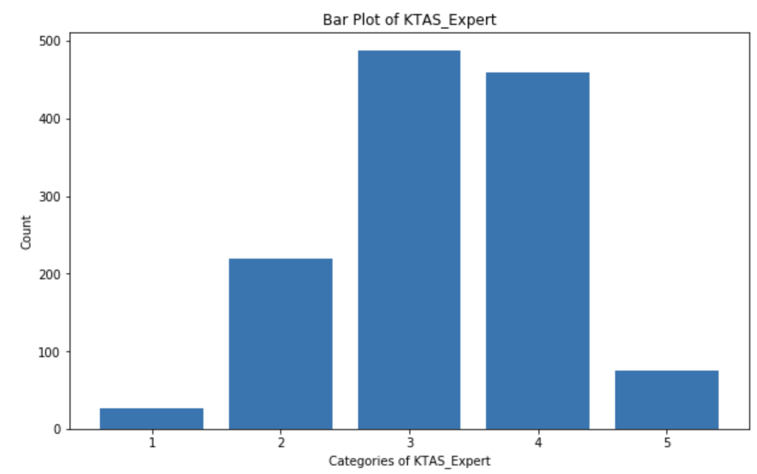
Running ML models with Over Sampling

Slide 11
Comparing different ML models +Over sampling

Slide 12
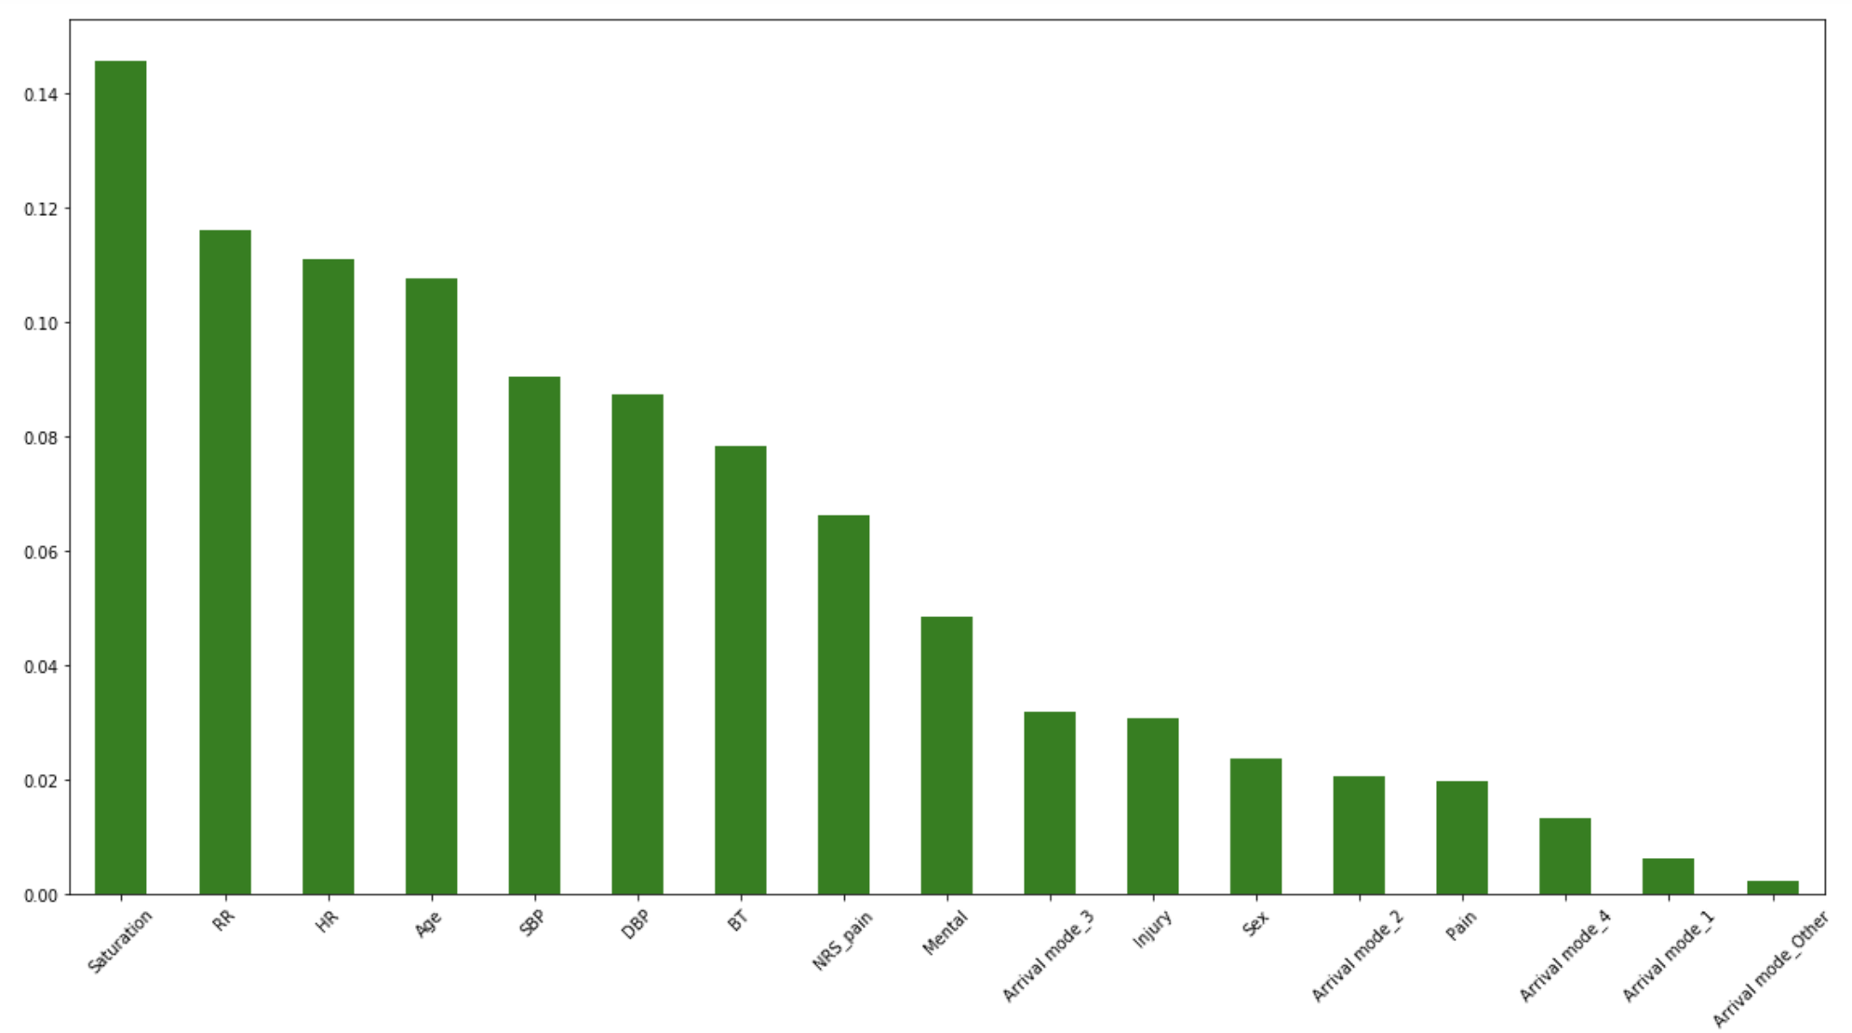
Features Importance in Random Forest Model

Slide 13
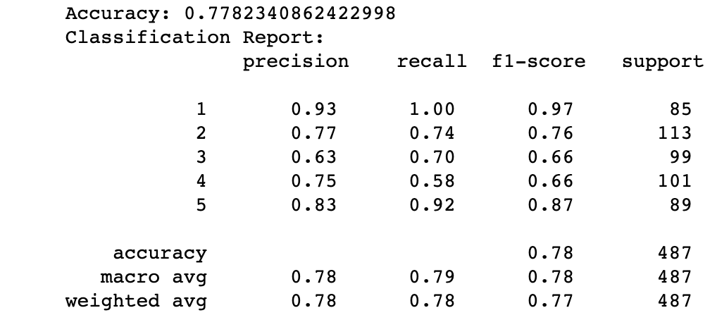
Winner: Random Forest + oversampling

Slide 14
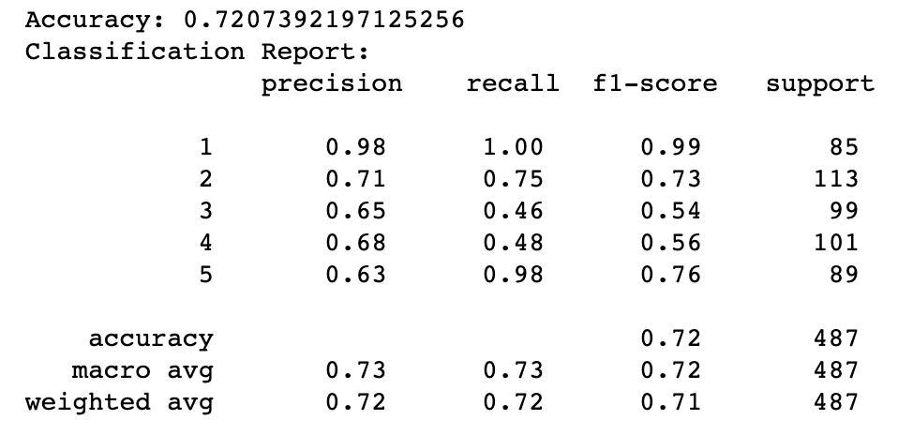
Second: K-Nearest Neighbor

